Slide 1
Agency Prepayment V2.10
July 2016

Slide 2
Three Problems Targeted to Fix in V2.1
1
Tracking after 2014 is too fast
The model tracking for post 2014 period seems much faster than actual
The problem is potentially caused by the dispersion of the market credit availability and the HPA 2yr index
We can choose a better index to track the market credit availability changes, and improve our fits
2
Loan size parameter is too flat
The low size parameter for lower than 300K rang is too flat in v2.0 model
We will focus on the lower loan size range (0-300K) in the new model version
3
High CLTV tracking is too slow
Our tracking for CR pools are too slow
The potential cause is the Turnover module is too slow for CRs(as most of the CR pools are out-of-money, Turnover model has the most impact on them)
We will re-visit the Turnover Lock-in and CLTV curves to fix the issue

Slide 3

Model Update Overview 1. Credit Availability Update
For the potential CAI inputs, we did a comparison using a automatic curve optimization framework.
Refi Module
Horse Race Framework
S-Curve
11 Parameters
3 Parameters
Automatic Curve Optimization
S Curve
Media Effect
Credit Availability
WALA
Burnout
Loan size
CLTV(Normal / HARP)
HARP-Eligible
Refi-Elig %
HARPed %
TPO %
S Curve
Media Effect
Generalised logistic function
Fixed
$$Y\left(t\right)=A+\frac{K−A}{{(C+Qe^{−B(t−M)})}^{1/ν}}$$
Credit Availability
HPA2Yr
MBA MCAI
Purchase Index
Cello MCAI
A: the lower asymptote
K: the upper asymptote.
B : the growth rate
nu: affects near which asymptote maximum growth occurs
Q : is related to the value Y(0)
Don’t use in the Horse Race
Optimization – Least Square
Compare Tracking Root Mean Squared Error (RMSE)

Slide 4
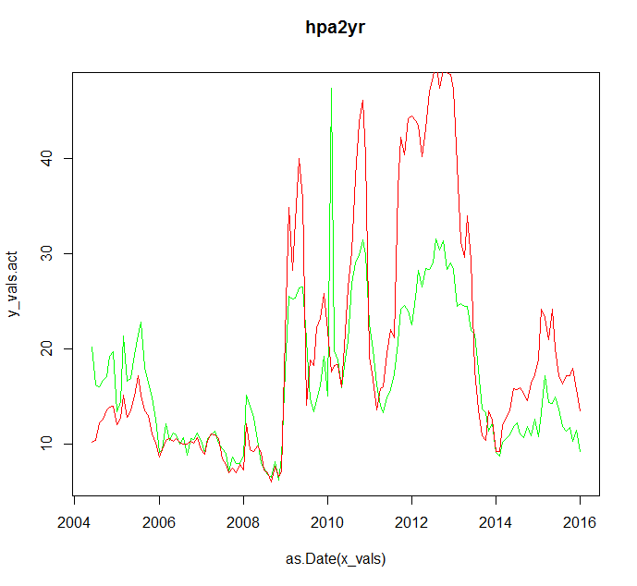
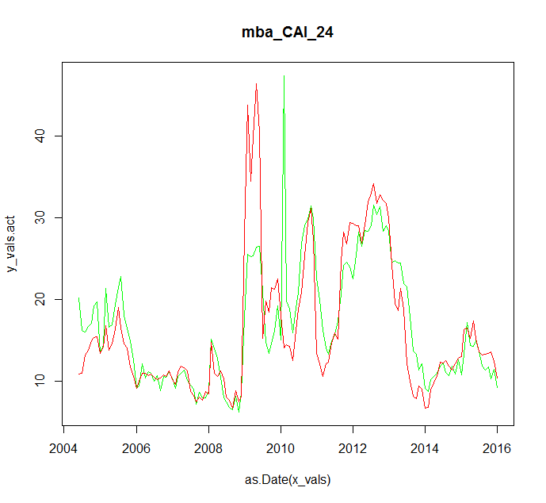
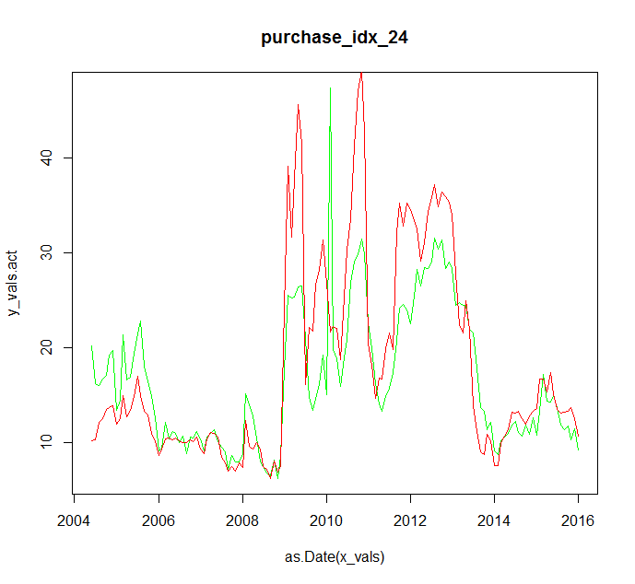
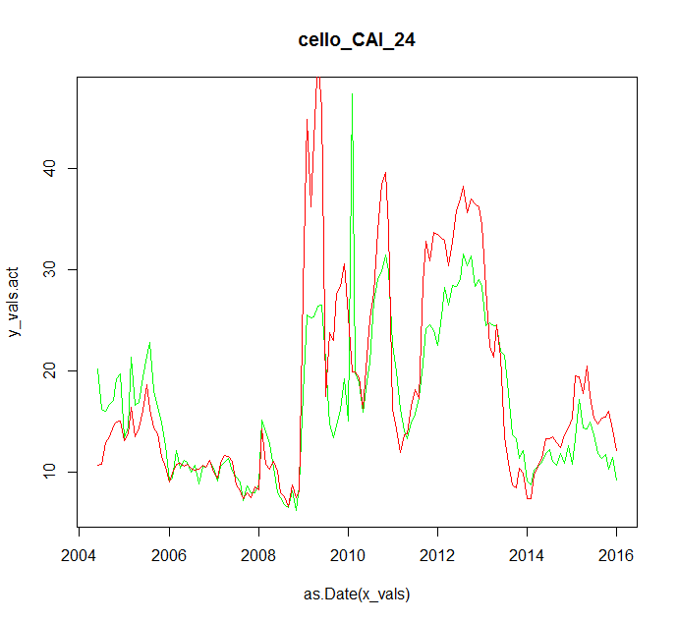
Model Update Overview 1. Credit Availability Update
RMSE = 7.9710e-2
RMSE = 7.7610e-2
RMSE = 7.8410e-2
RMSE = 7.8410e-2
Using the four candidate CAIs, we tested the tracking from 2004 to 2016. The total RMSE shows the three new curves have better fits compared with the HPA-2yr index. The MBA CAI has the best performance among the four.

Slide 5
Model Update Overview 1. Credit Availability Update
 | mba_CAI | purchase_idx | cello_CAI
24 Month | 0.0775741 | 0.0784130 | 0.0783926
18 Month | 0.0770801 | 0.0787880 | 0.0777685
12 Month | 0.0791511 | 0.0791555 | 0.0862411
6 Month | 0.0783332 | 0.0807010 | 0.1008529
From the RMSE numbers showed above, the best combination is MBA MCAI with 18 month moving average.
All the three curves with moving average of 24 or 18 month have a good performance in the tracking test. We can choose one of them based on other considerations, such as the difficulty of obtaining data.

Slide 6
VI. Backfill MBA CAI Using Purchase Data
As the MBA CAI data is only available after 2004, we need to back fill the data set. Here we choose Purchase data to do a regression, and generate the data for MBA CAI.
Using a simple linear regression on Purchase data set, we can back fill the MBA-CAI time series historical data.

Slide 7
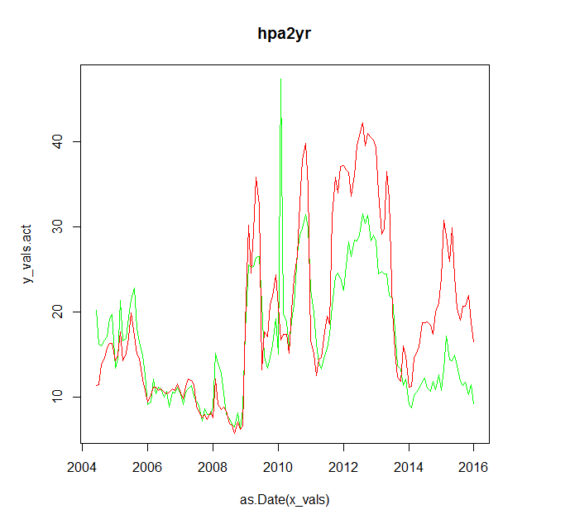
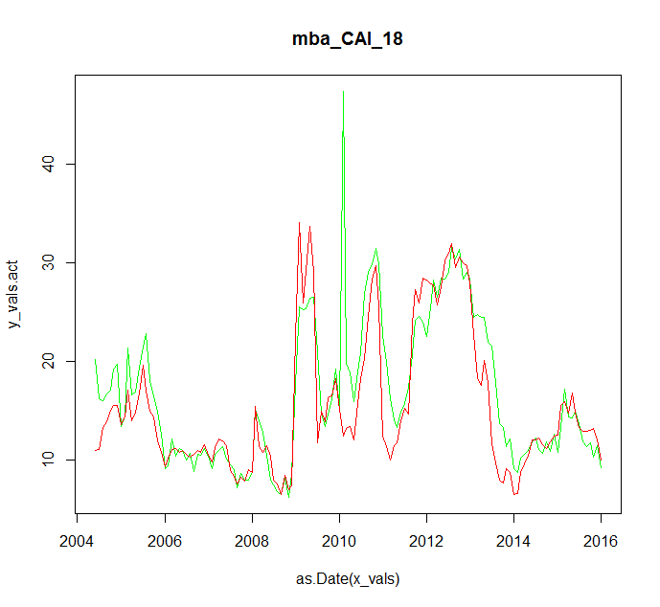
Model Update Overview 1. Credit Availability Update
Tracking Result Using Current HPA2Yr Model
Tracking Result Using MBA MCAI 18 Month
From the charts, we can see a clearly potential of improvement of model fitting. Especially, the issue that model tracking is too fast after 2014 will be fixed.

Slide 8
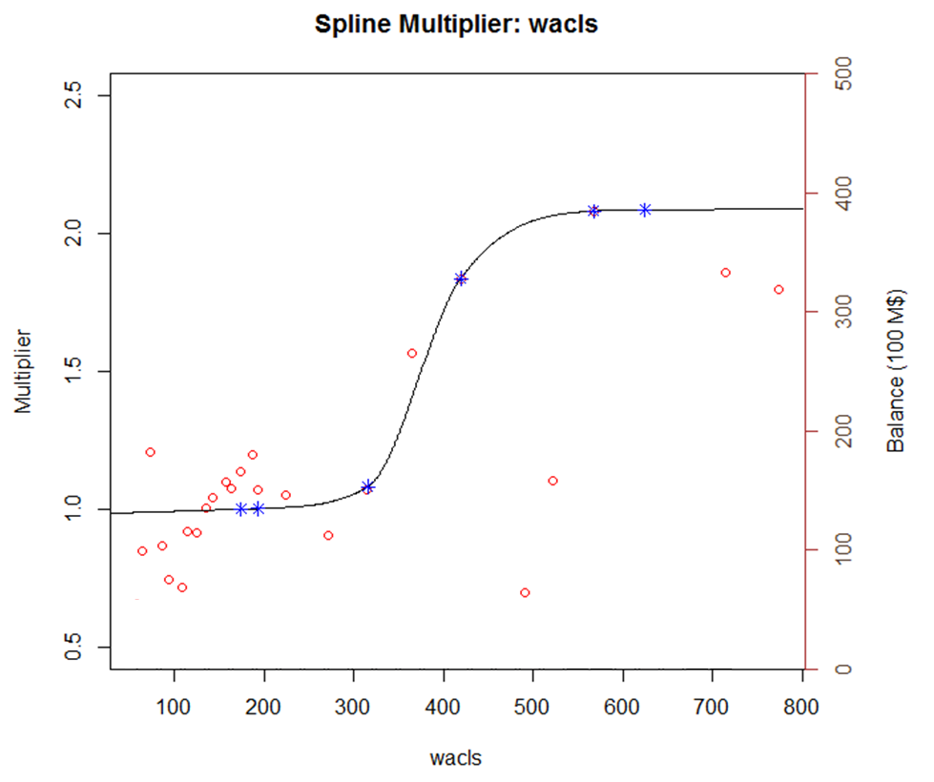
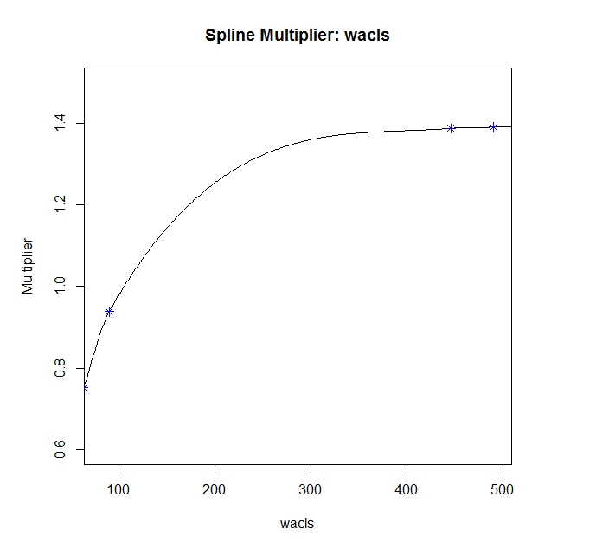
Model Update Overview 2. Loan Size
Loan Size Curve in V2.00
Loan Size Curve in V2.10
In v2.1, we decided to focus on the rang between 0-300K, where most of the data falls in. In that way, we can better fit the changes in the circled range.

Slide 9
Model Update Overview 3. High CLTV
In v2.0, the model tracking for high CLTV pools are too slow. The difference is coming from both turnover and refinance. But as the high LTV pools are mostly out of money, the turnover model might have a greater influence on the performance.
The improvement focused on the higher end of CLTV curve, and make sure the cap/floor function don’t push the curve too low when CLTV increases.
From the tracking result, we can see model v2.1 bring the tracking to the right level for U9 pools.

Slide 10
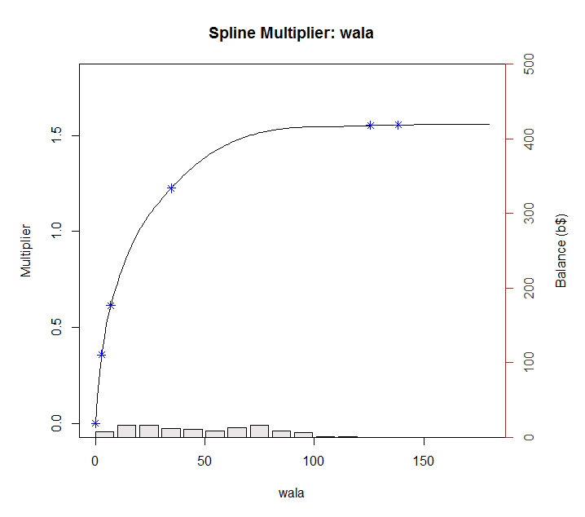
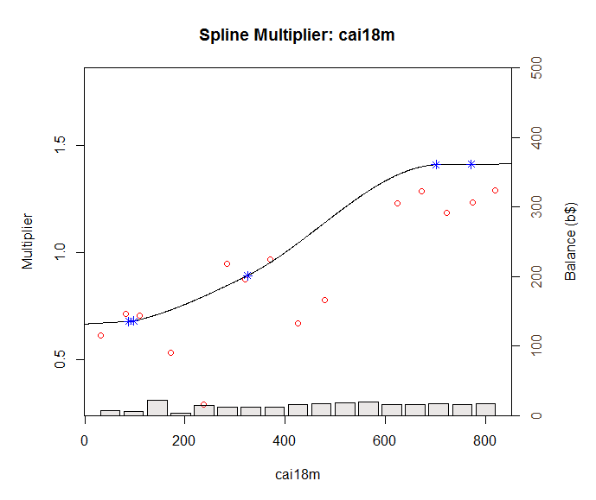
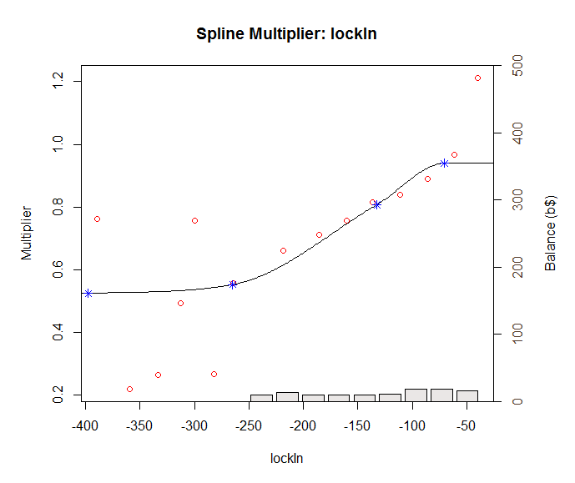
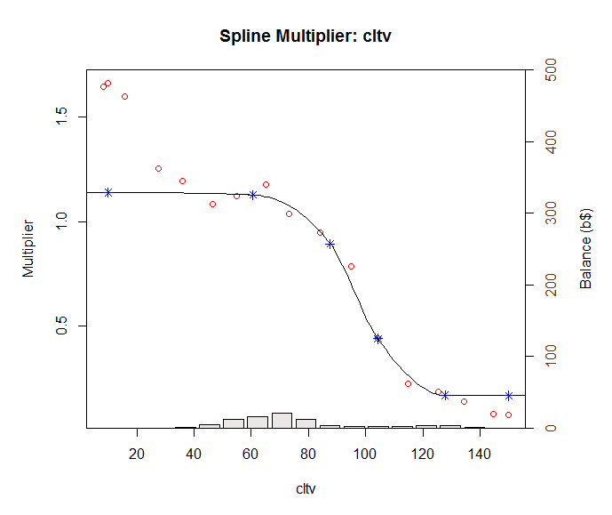
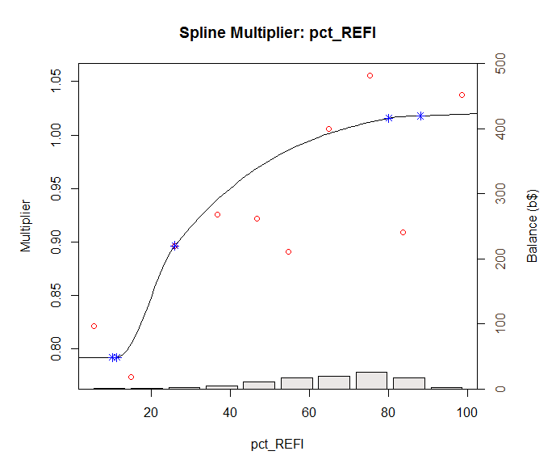
Curve Updates Turnover
As the credit availability parameter is the second in the sequential fitting process. After fitting it, we need to re-built all other curves after it.
WALA is not affected by the update.

Slide 11
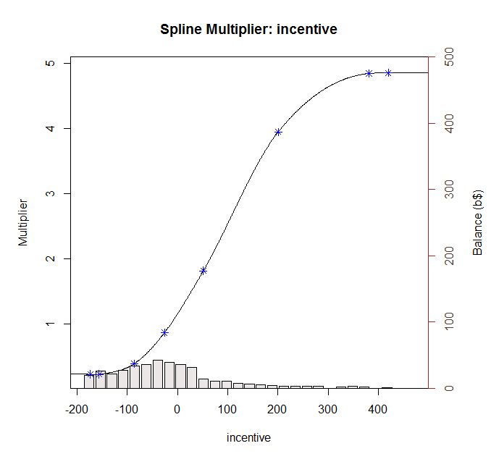
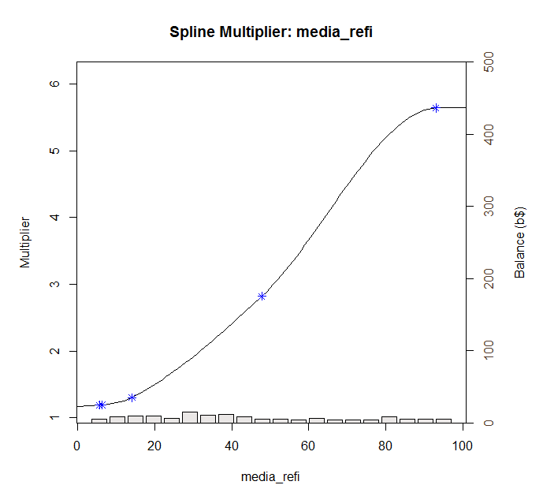
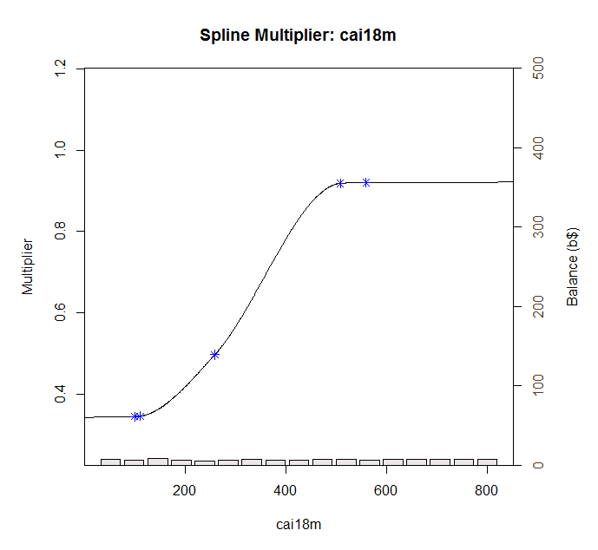
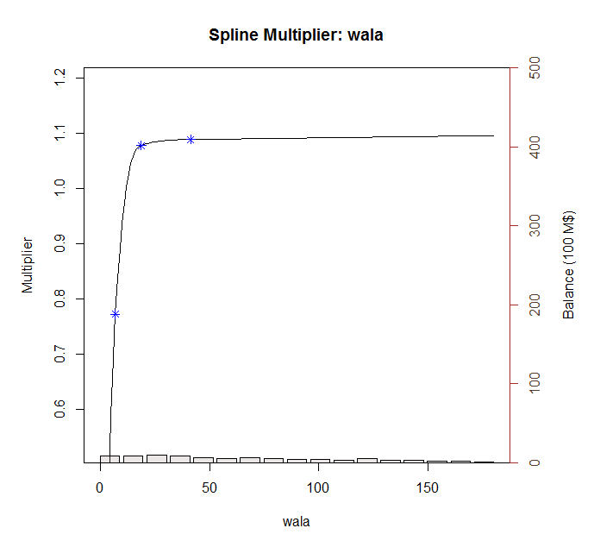
Curve Updates Refinance
Similar as Turnover, the credit availability parameter is the third in the sequential fitting process. After fitting it, we need to re-built all other curves after it. And due to the Turnover model update, the baseline curve also need to be updated.

Slide 12
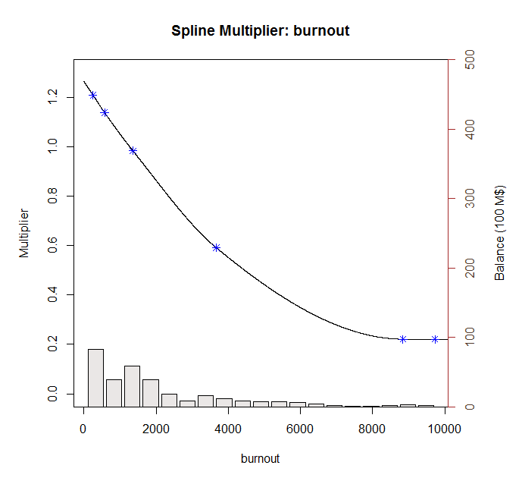
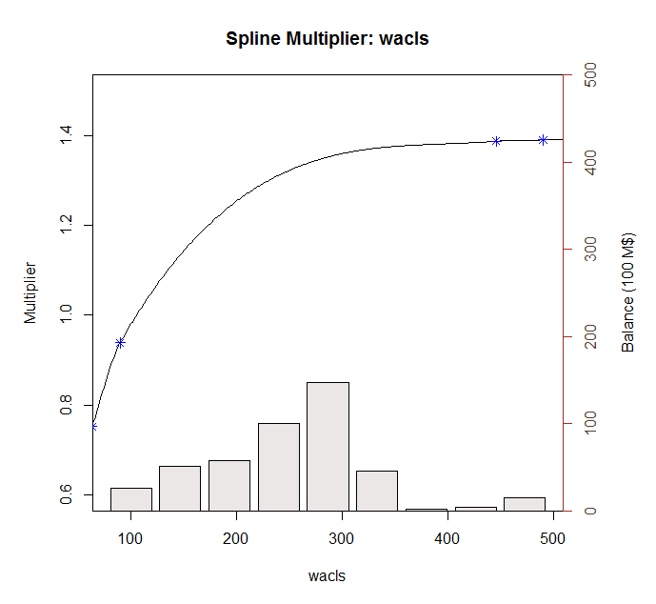
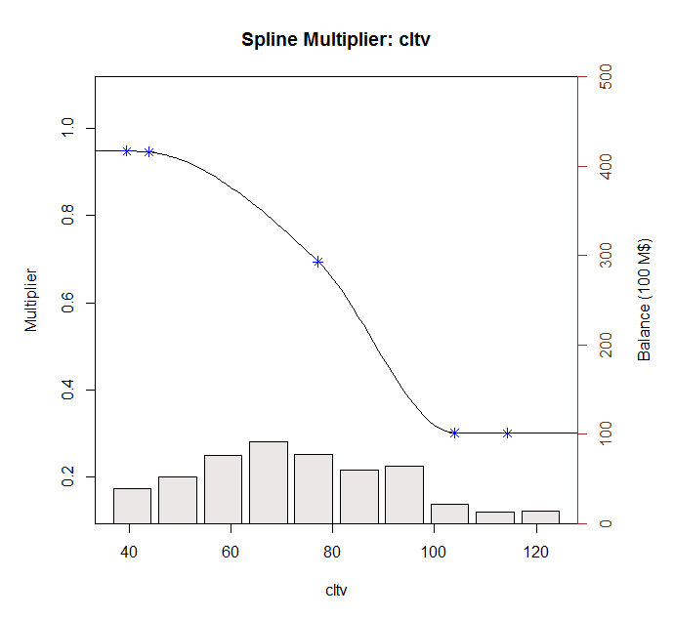
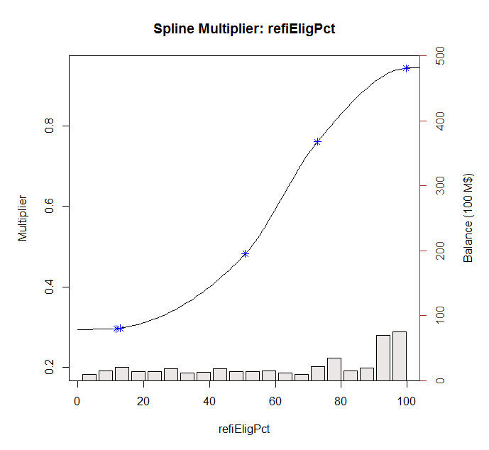
Curve Updates Refinance
Similar as Turnover, the credit availability parameter is the third in the sequential fitting process. After fitting it, we need to re-built all other curves after it. And due to the Turnover model update, the baseline curve also need to be updated.

Slide 13
Model Tracking Result
From the overall tracking, we can see the v2.1 model has better performance for post 2014 period. As the new credit availability input fixed the dispersion from market credit availability and the HPA 2Yr seriese.

